Slide 1
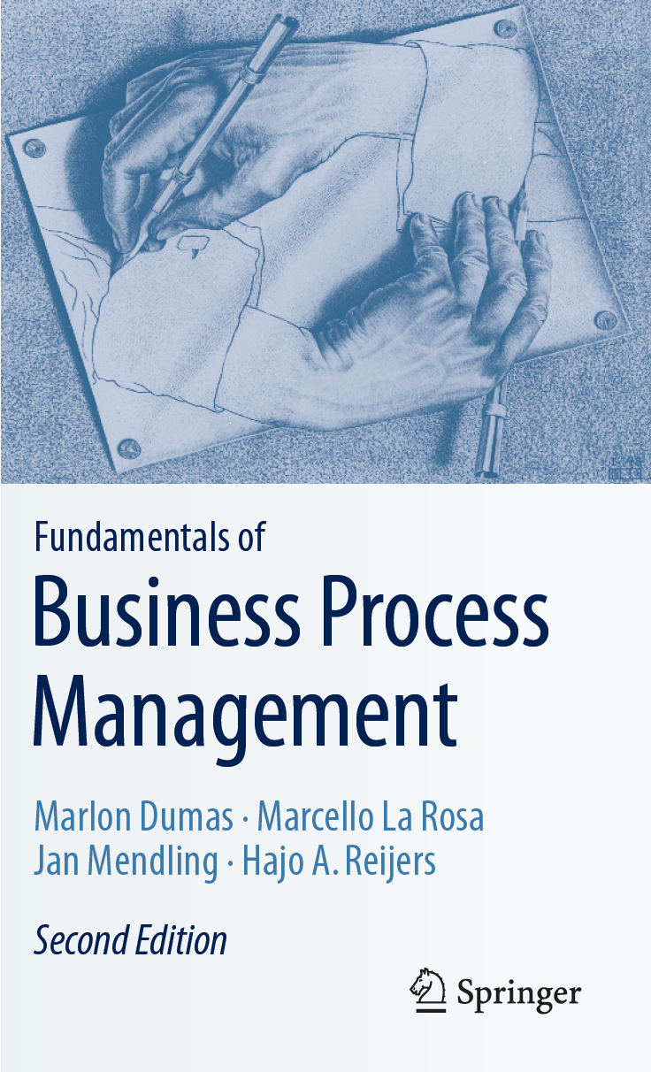
Chapter 6: Qualitative Process Analysis
Contents
Value-Added Analysis
Waste Analysis
Stakeholder Analysis & Issue Documentation
Root-Cause Analysis
Recap

Slide 2
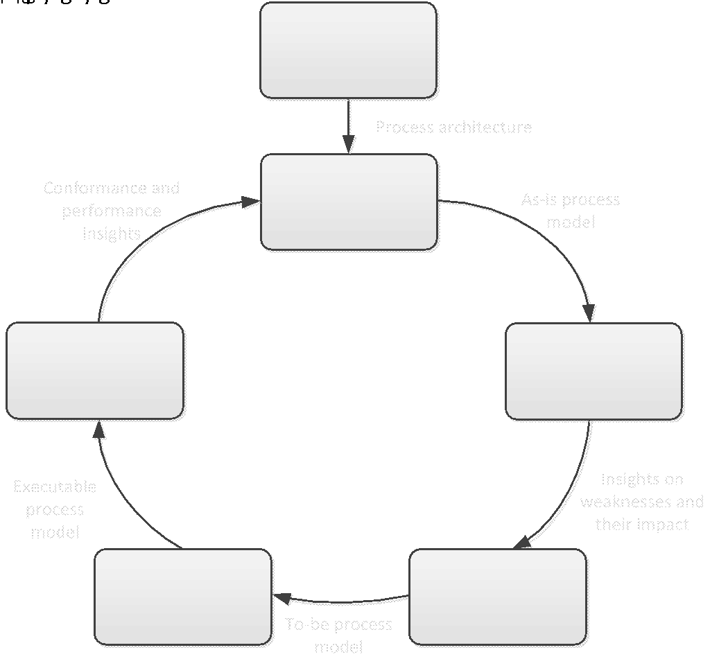
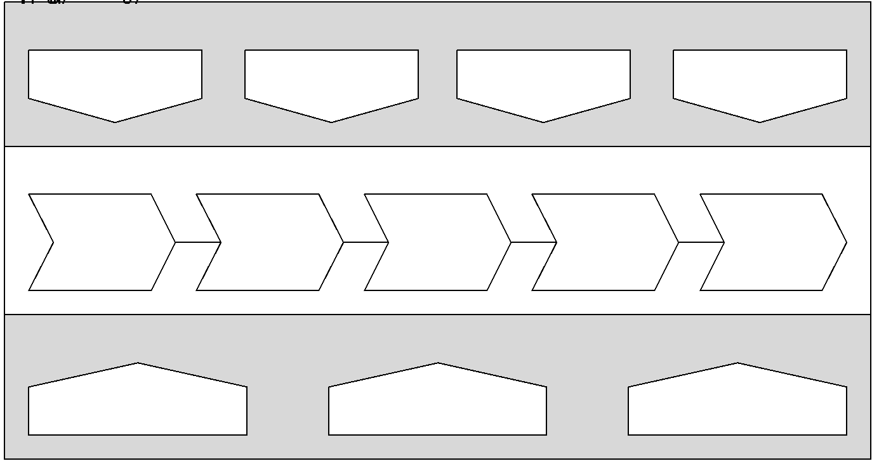
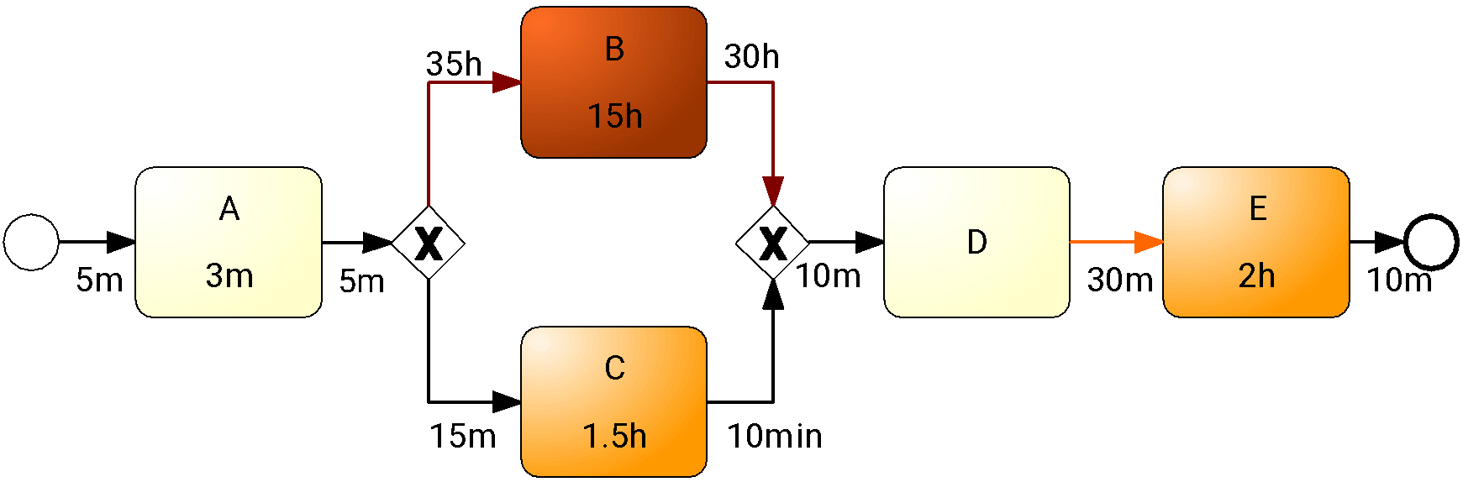
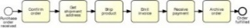
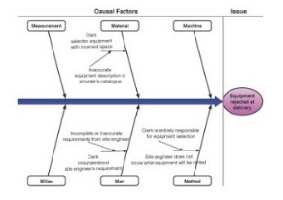
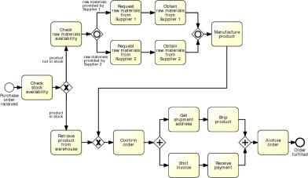
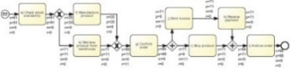
Process Analysis in the BPM Lifecycle

Slide 3
Qualitative Process Analysis: Overview
Stakeholder analysis
Value-Added & Waste Analysis
Root-Cause Analysis
Issue Register & Pareto Chart

Slide 4
Chapter 6: Qualitative Process Analysis
Contents
Value-Added Analysis
Waste Analysis
Stakeholder Analysis & Issue Documentation
Root-Cause Analysis
Recap

Slide 5
Value-added analysis
Decorticate the process into steps
Steps performed before a task
The task itself, possibly decomposed into smaller steps
Steps performed after a task, in preparation for the next task
Classify each step
Value-adding (VA)
Business value-adding (BVA)
Non-value-adding (NVA)

Slide 6
Value-adding activities
Produces value or satisfaction to the customer.
Criteria:
Is the customer willing to pay for this step?
Would the customer agree that this step is necessary to achieve their goals?
If the step is removed, would the customer perceive that the end product or service is less valuable?
Examples:
Order-to-cash process: Confirm delivery date, Deliver products
University admission process: Assess application, Notify admission outcome

Slide 7
Business value-adding activities
Necessary or useful for the business to operate.
Criteria
Is this step required in order to collect revenue, to improve or grow the business?
Would the business (potentially) suffer in the long-term if this step was removed? Does it reduce risk of business losses?
Is this step required in order to comply with regulatory requirements?
Example
Order-to-cash process: Check purchase order, Check customer’s credit worthiness, Issue invoice, Collect payment, Collect customer feedback
University admission process: Verify completeness of application, Check validity of degrees, Check validity of language test results

Slide 8
Non-value-adding activities
Everything else besides VA and BVA
Incudes:
Handovers, context switches
Waiting times, delays
Rework or defect correction
Examples
Order-to-cash: Forward PO to warehouse, Re-send confirmation, Receive rejected products
University admission: Forward applications to committee, Receive admission results from committee

Slide 9
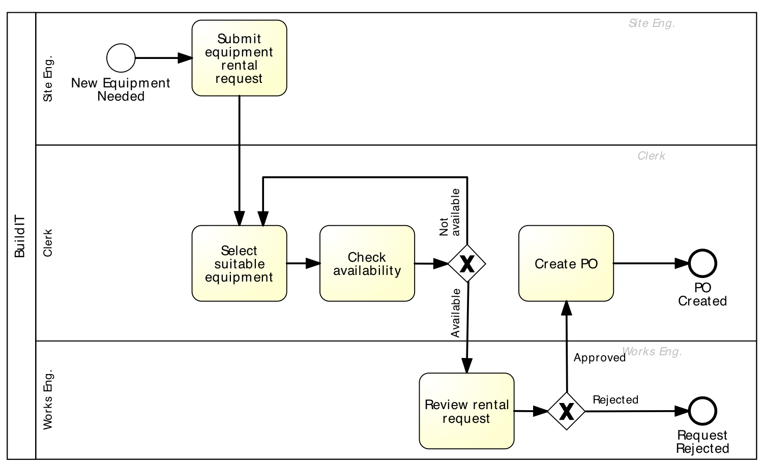
Extract of Equipment Rental Process
Fill request (VA)
Send request to clerk (NVA)
Check equipment availability (VA) – 1st time
Record recommended equipment (BVA)
Forward request to works engineer (NVA)
Open and read request (NVA)
Select suitable equipment (VA) – 1st time
Produce PO (BVA)
Submit PO to supplier (VA)
Open and examine request (BVA)
Communicate issues (BVA)
Forward request back to clerk (NVA)

Slide 10
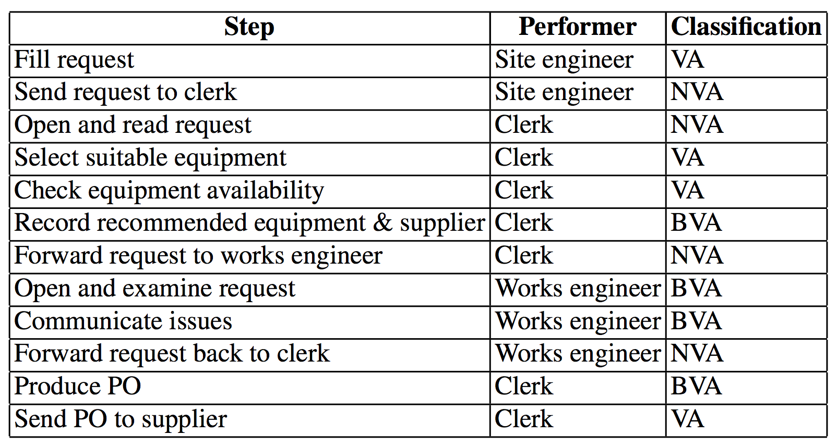
Equipment Rental Process – VA Analysis

Slide 11
Exercise
Pharmacy prescription process (Exercise 1.6)
Identify at least three VA steps, at least three BVA steps and at least three NVA steps

Slide 12

Lean Process

Slide 13
The Lean Process
A method for creating a more effective business by eliminating wasteful practices and improving efficiency
Core idea is to maximize customer value while minimizing waste
By reducing waste and improving customer satisfaction, the lean process saves companies money and improves overall profitability
Lean is a way of thinking and acting for an entire organization
Businesses in all industries and services, including healthcare and governments, are using lean principles as the way they think and do

Slide 14
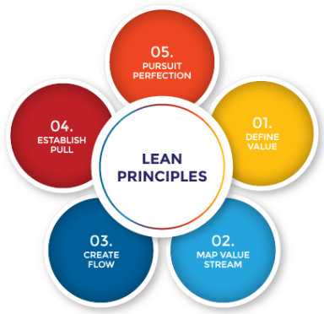
Five Lean Principles

Slide 15
Define Value
Value is what the customer is willing to pay for
It is very important to discover the actual or latent needs of the customer
Sometimes customers may not know what they want or are unable to articulate it – common when it comes to novel products or technologies
Techniques such as interviews, surveys, demographic information, web analytics, etc., could help discover:
what customers find valuable
how they want the product or service to be delivered
price that they afford

Slide 16
Map the Value Stream
Use the customer’s value as a reference point and identify all the activities that contribute to these values
Activities that do not add value to the end customer are considered waste
By reducing and eliminating unnecessary processes or steps, it is ensured that customers are getting exactly what they want while at the same time reducing the cost of producing that product or service

Slide 17
Create Flow
After removing the wastes from the value stream, the following action is to ensure that the flow of the remaining steps run smoothly without interruptions or delays
Some strategies for value-adding activities flow smoothly include:
Breaking down steps;
Reconfiguring the production steps;
Levelling out the workload;
Creating cross-functional departments; and
Training employees to be multi-skilled and adaptive

Slide 18
Establish Pull
Inventory is considered one of the biggest wastes in any production system
The goal of a pull-based system is to limit inventory and work in process (WIP) items while ensuring that the requisite materials and information are available for a smooth flow of work
A pull-based system allows for Just-in-time delivery and manufacturing where products are created at the time that they are needed and in just the quantities needed
Pull-based systems are always created from the needs of the end customers
It is ensured that the products produced will be able to satisfy the needs of customers

Slide 19
Pursue Perfection
Wastes are prevented through the achievement of the first four steps with ‘pursuing perfection’ being the most important of them
It makes Lean thinking and continuous process improvement a part of the organizational culture
Every employee should strive towards perfection while delivering products based on the customer needs
The company should be a learning organization and always find ways to get a little better each and every day

Slide 20
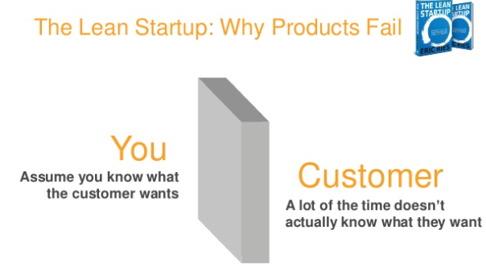

Slide 21
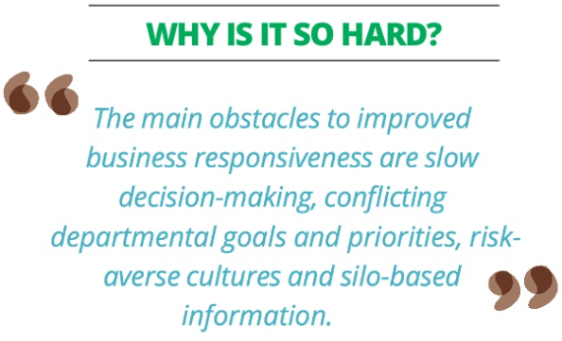

Slide 22
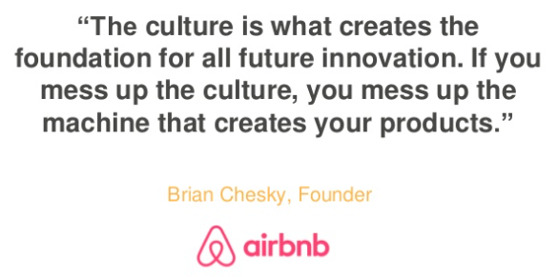

Slide 23
Chapter 6: Qualitative Process Analysis
Contents
Value-Added Analysis
Waste
Move
Hold
Overdo
Stakeholder Analysis & Issue Documentation
Recap

Slide 24
Business Waste
Anything that doesn’t increase value in the eye of the customer must be considered ‘waste’.
There are 7 manufacturing wastes, which have a universal application to businesses today.
Move: Wastes that are related to movement. This category includes two types of waste: transportation and motion.
Hold: Wastes arising from holding something. Again, this category includes two types of waste: inventory and waiting.
Overdo: Wastes arising from doing more than is necessary in order to deliver value to the customer or the business. This category encompasses three types of waste: defects, overprocessing, and overproduction
Notes:
Every effort should be made to eliminate that waste.

Slide 25
Defects
Mistakes that require additional time, resources, and money to fix
Completely eradicating any form of waste is impossible
Defects can be limited by application of standardized work plans, strict quality controls, full understanding of work requirements and customer needs.
Some causes of defects include:
Poor quality controls
Poor repair
Poor documentation
Lack of standards
Weak or missing processes
Misunderstanding customer needs
Poor design and undocumented design changes
Notes:
Defect waste refers to all work performed in order to correct, repair, or compensate for a defect in a process. Defect waste encompasses rework, meaning situations where we have to perform again a task that we have previously executed in the same case, because of a defect the first time the task was performed. In a travel requisition process, an example of a defect waste is when a travel requisition request is sent back by the approver to the requestor for revision because some data was missing.

Slide 26
Overproduction
In some organizations, workers blindly keep producing even when those who receive their output either aren’t ready for it or don’t need it
It can tie up significant working capital
Solution is to establish a reasonable work flow for the benefit of the customer
Causes of overproduction include:
Just-in-case production
Unclear customer needs
Producing to a forecast
Long set-up times
Engineering changes
Poorly applied automation

Slide 27
Overprocessing
Overprocessing also refers to as extra processing refers to work that is performed unnecessarily. It includes unnecessary perfectionism, but it also includes tasks that are performed and later found not to be necessary.
Often occurs due to the creation of multiple versions of the same task .Solution is to standardize processes, empower employees and eliminate unnecessary documentation, sign-off processes and meetings
Examples include:
Excessive reports
Multiple signatures
Re-entering data and duplicated data
Lack of standards
Poor communication
Overdesigned equipment
Misunderstanding customer’s needs
Human error
Notes:
Another type of waste in this category is called overprocessing. Overprocessing refers to work that is performed unnecessarily given the outcome of a process instance. It includes unnecessary perfectionism, but it also includes tasks that are performed and later found not to be necessary

Slide 28
Inventory
This waste occurs when there is supply in excess of real customer demand, which masks real production
Causes include:
Overproduction and buffers
Poor monitoring systems
Mismatched production speeds
Unreliable suppliers
Long set-up times
Misunderstood customer needs

Slide 29
Waiting
Whenever work has to stop for some reason – i) next person in line is overwhelmed; ii) something broke down; iii) waiting for approval or material;
Solution is to provide adequate staffing to handle the workload at the bottlenecks
Causes include:
Unbalanced workloads
Unplanned downtime
Long set–up times
Producing to a forecast
Insufficient staffing
Work absences
Poor process quality
Poor communication

Slide 30
Transportation
Wastes caused by moving things around
Too much transportation tends to increase costs, wastes time, increases the likelihood of product damage and deterioration, and can result in poor communication
Limiting transportation waste can be done by simplifying processes, repairing physical layouts and handling products less often
Causes include:
Poor plant/office layout
Unnecessary or excessive steps in the process
Poorly-designed systems

Slide 31
Motion
Any excess movement of process participants that doesn’t add value to the product, service or process
Solution is to rearrange layouts to decrease the distance between stations and make it easier to reach things that are often used
Causes include:
Poor process design and controls
Poor workstation/shop layout
Shared tools and machines
Workstation congestion
Lack of standards

Slide 32
Non-utilized talent
Not or under-utilizing people’s talents, skills and knowledge can have a detrimental effect on an organization
Companies can experience great benefits when recognizing the value of skills and improvement ideas from all levels of the business and can suffer when not effectively engaging in the process
Non-utilizing talent can be seen with:
Assigning staff to wrong tasks
Wasteful admin tasks
Poor communication
Lack of teamwork
Poor management
Insufficient training

Slide 33
Benefits of Waste Elimination
Systematic elimination of DOWNTIME can result in:
Faster processes
Lower costs
Higher quality
Happier workers, and most importantly
Happier customers

Slide 34
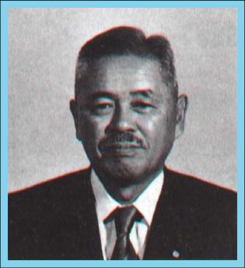
Waste analysis
"All we are doing is looking at the time line, from the moment the customer gives us an order to the point when we collect the cash.
And we are reducing the time line by reducing the non-value-adding wastes ”
Taiichi Ohno

Slide 35
Seven sources of waste
Move
Unnecessary Transportation
Motion
Hold
Inventory
Waiting (and idleness)
Over-do
Defects
Over-Processing
Over-Production

Slide 36
Move

Slide 37
Unnecessary transportation
Send or receive materials or documents (incl. electronic) taken as input or output by the process
Example:
To apply for admission at a University, students fill in an online form. When a student submits the online form, a PDF document is generated. The student is requested to download it, sign it, and send it by post together with the required documents: 1. Certified copies of degree and academic transcripts. 2. Results of language test. 3. CV. When the documents arrive to the admissions office, an officer checks their completeness. If a document is missing, an e-mail is sent to the student. The student has to send the missing documents by e-mail or post depending on document type.

Slide 38
Motion
Motion of resources internally within the process
Common in manufacturing processes, less common in business processes
Examples
Vehicle inspection process, a process worker moves with the inspection forms from one inspection base to another; in some cases inspection equipment also needs to be moved around
Approval process, a process workers moves around the organization to collect signatures

Slide 39
Hold

Slide 40
Inventory
Materials inventory
Work-in-process (WIP)
Examples
Vehicle inspection process, when a vehicle does not pass the first inspection, it is sent back for adjustments and left in a pending status. At a given point in time, about 100 vehicles are in the “pending” status across all inspection stations
University admission process: About 3000 applications are handled concurrently

Slide 41
Waiting
Waiting for materials or input data
Task waiting for a resource
Resource waiting for work (resource idleness)
Examples
Vehicle inspection process: A technician at a base of the inspection station waiting for the next vehicle
Approval process: Request waiting for approver
University admission process: Incomplete application waiting for additional documents; batch of applications waiting for committee to meet

Slide 42
Over-do

Slide 43
Defects
Correcting or compensating for a defect
Rework loops
Examples
Vehicle inspection: A vehicle needs to come back to a station due to an omission
Travel approval: Request sent back to requestor for revision
University admission: Application sent back to applicant for modification; request needs to be re-assessed later due to incomplete information

Slide 44
Over-processing
Tasks performed unnecessarily given the outcome of the process
Unnecessary perfectionism
Examples
Vehicle inspection: Technicians take time to measure vehicle emissions with higher accuracy than required, only to find that the vehicle clearly does not fulfill the required emission levels
Travel approval: 10% of approvals are trivially rejected at the end of the process due to lack of budget
University admission: Officers spend time verifying the authenticity of degrees, transcripts and language test results. In 1% of cases, these verifications uncover issues. Verified applications are sent to the admissions committee. The admission committee accepts 20% of the applications it receives

Slide 45
Over-production
Unnecessary process instances are performed, producing outcomes that do not add value upon completion
Examples
Order-to-cash: In 50% of cases, issued quotes do not lead to an order
Travel approval: In 5% of cases, travel requests are approved but the travel is cancelled
University admission: About 3000 applications are submitted, but only 800 are considered eligible after assessment

Slide 46
Equipment rental process: wastes
Send request to clerk (Transp.)
Defect
Open and read request
(Handover 🡪 transportation)
Forward request to
works engineer (Transp.)
Forward request back to clerk (Transp.)

Slide 47
Equipment rental process: wastes
Transportation
Site engineer sends request to clerk
Clerk forwards to works engineer
Works engineer send back to clerk
Inventory
Equipment kept longer than needed
Waiting
Waiting for availability of works engineer to approve

Slide 48
Equipment rental process: wastes
Defect
Selected equipment not available, alternative equipment sought
Incorrect equipment delivered and returned to supplier
Over-processing
Clerk finds available equipment and rental request is rejected because equipment not needed
Rental requests being approved and then canceled by site engineer
Over-production
Equipment being rented and not used at all

Slide 49
Exercise
Pharmacy prescription process (Exercise 1.6)
Identify wastes in this process

Slide 50
Recap
Segregate value-adding, business value-adding and non-value-adding steps
Identify waste: move, hold, overdo
Collect and systematically organize issues, assess their impact, priotirize
Analyze root causes of issues

